Slide 1
Computer Networks
Fall Semester, 2025

Slide 2











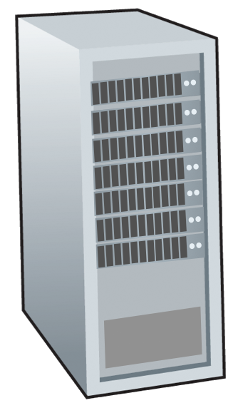









We are connected everyday and everywhere
mobile network
national or global ISP
local or regional ISP
home network
content
provider
network
datacenter
network
enterprise
network

Slide 3


为什么要学习计算机网络--考研

Slide 4
为什么要学习计算机网络—保研
中山大学计算机学院：
  超算中心
  量子计算与软件研究所
  大数据与计算智能研究所
  人工智能与无人系统研究所
  科学计算研究所
  网络空间安全研究所
  先进网络与计算系统研究所

Slide 5
为什么要学习计算机网络—工作
华为
运营商 (移动/联通/电信)
百度/腾讯/阿里/字节
京东
小米
Google/Amazon/Meta

Slide 6
Computer Networks
Instructor: Qianyi Huang (黄倩怡)
Affiliation: CSE of SYSU
Email: huangqy89@mail.sysu.edu.cn
Office: 529F, Guangzhou Supercomputing Center, East Campus
Office Hour: by appointment

Slide 7
Teaching Assistant
Yihang Zhang (张漪航)
  982770372@qq.com
  Yutong Xu (许雨彤)
  xuyutong0302@gmail.com
TA office: 529, Guangzhou Supercomputing Center, East Campus
They are responsible for homework grading, Q&A, etc

Slide 8
Course Website
https://huangqy89.github.io/cn-2025/
Lecture notes
Assignments & Solutions
Laboratory materials
Additional resources (reference books, online courses)

Slide 9


Textbook
Book
  教材名称：计算机网络：自顶向下方法 (原书第8版)
  作者：[美] James F.Kurose，Keith W.Ross 著，陈鸣 译
  出版社：机械工业出版社

Slide 10
What Will We Learn?
Internet
Layered architecture
  Application layer
  Transport layer
  Network layer
  Link layer
Protocols, e.g., TCP/IP
We will cover up to Section 7.3

Slide 11
Challenges
A lot of terminologies
  HTTP, SMTP, FTP, TCP, UDP, TLS, etc
Computer networks are quite complicated systems
  Various configurations, a lot of details
This topic is evolving…

Slide 12
Additional Resources
Computer Networks: A Top-down approach, by Jim Kurose
  https://gaia.cs.umass.edu/kurose_ross/index.php
  Videos, Knowledge checks, Interactive End-of-Chapter Problems
中科大郑烇、杨坚全套《计算机网络（自顶向下方法 第7版，James F.Kurose，Keith W.Ross）》课程
  https://www.bilibili.com/video/BV1JV411t7ow/?share_source=copy_web&vd_source=aa6451f6e14c3ab9b1d86b1c2c7e09ee

Slide 13
Schedule
Class Lecture:
  Teaching Building: D104 (Monday, 8:00 – 9:40, Week 1-17)
  Teaching Building: D104 (Wednesday, 16:30 – 18:10, Week 1 to Week 9)
Lab Section
  Monday, 16:30-18:10, Week 1-17
  Experimental Building D402

Slide 14
Grading Policy
Regular grades 40%
  Homework: 35%
  Quiz : 5%
  Absence: -1 per time
  Answer questions correctly: +1 per time
Final Exam (closed book) 60%

Slide 15
Suggestions
Do the reading carefully
Do all the homework carefully
Take full advantage of online resources
If you’re struggling, get help from the instructor & TAs

